Slide 1


Transport-Layer Load Balancing
H. Jonathan Chao
ECE NYU
chao@nyu.edu

Slide 2
Outline
Background of transport-layer load balancing
2014 Duet: cloud scale load balancing
2017 Silkroad: making stateful layer-4 load balancing fast and cheap
2018 Beamer: stateless datacenter load-balancing
2020 Spotlight: scalable transport layer load balancing

Slide 3














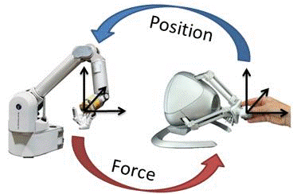


Various Application over Internet
Internet Backbone
ISP Network
Core Cloud
Emerging mobile application require low-latency
Radio Access Network
Mobile Backhaul (IP Transport)
Evolved
Packet
Core
(Mobile Core)
Edge Cloud

Slide 4
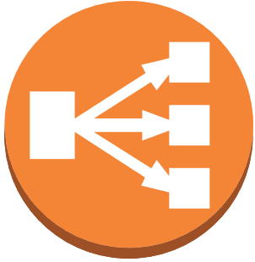
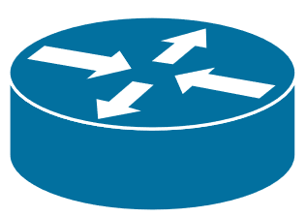
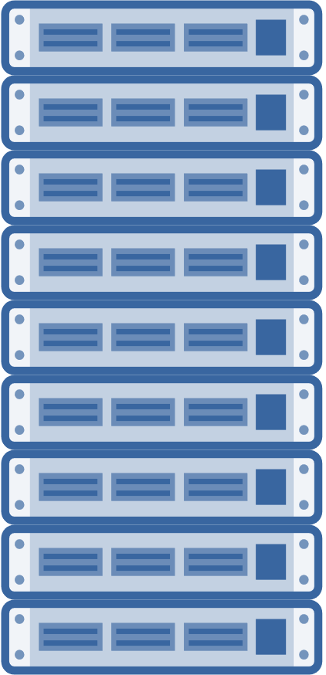
Distributed applications use L4 load balancers
Serving applications are replicated for horizontal scalability, which is transparent to users
Transport-layer load balancers abstract the distributed instances into one instance
Users access a Virtual IP address (VIP)
The load balancer assigns the connection to one of the instances with a direct IP address (DIP)
VIP/DIP are swapped at a balancer
Request → VIP
The Internet
Data Center
Request → DIP
Data Center Network

Slide 5



Dedicated load balancing does not scale
Before SDN, load balancers were implemented as dedicated middlewares implemented at the core of data center networks
As users grow and distributed applications add more instances, a dedicated load balancer cannot keep up with the traffic
Adding more load balancers in a distributed manner can scale up the system
The Internet
Data Center
Data Center Network

Slide 6
Distributed Load Balancing
With adoption of SDN, ToR switches are upgraded to programmable switches
Transport-layer load balancing can be implemented as a network function on programmable ToRs.
The load balancing function also scales horizontally as we add more racks and servers
Intra-data center traffic is also load balanced, where a request from a user can be directed to an instance at a different rack
Request → VIP
The Internet
Data Center
Core Routers
Data Center Network
ToR: Programmable Switch
Request → DIP
Request → DIP
Request → VIP

Slide 7
Distributed Load Balancing: Challenges
Flow Dispatching: How new connections are assigned to DIPs?
Addition or removal of DIPs results in rehashing
Per-connection consistency (PCC): Connection-to-instance mapping should be consistent
Data Center Network
Connection #1 | DIP₅
Connection #2 | DIP₁
… | …
Notes:
Show that we have many LBs
Do not spend too much time here
7 minutes here

Slide 8
1. Duet
[Duet`14]: Gandhi, Rohan, et al. "Duet: Cloud scale load balancing with hardware and software." ACM SIGCOMM Computer Communication Review 44.4 (2014): 27-38.

Slide 9
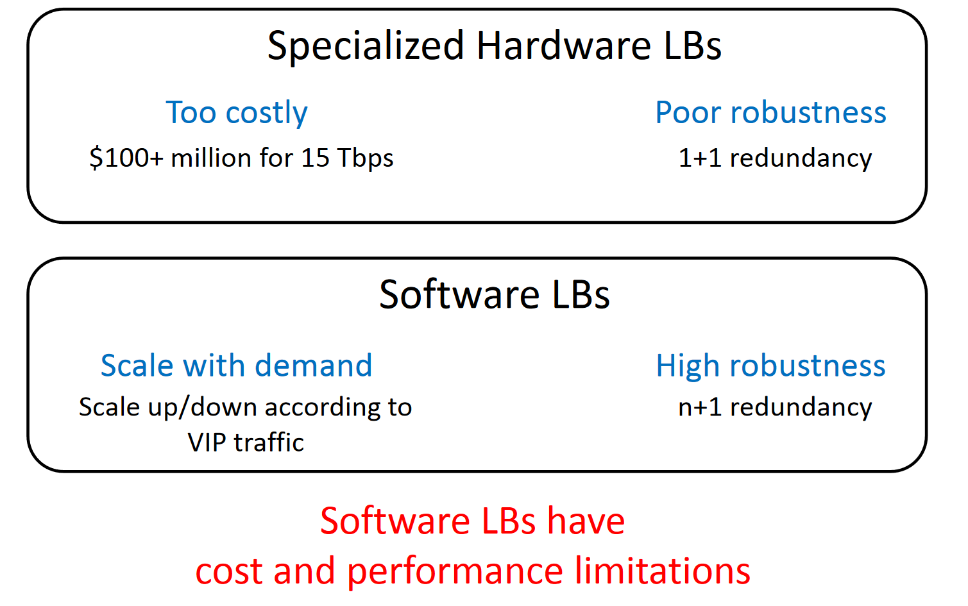
Duet: Software + Hardware LB
Software disadvantage: Performance limitation
Notes:
Just address performance limitation for software

Slide 10
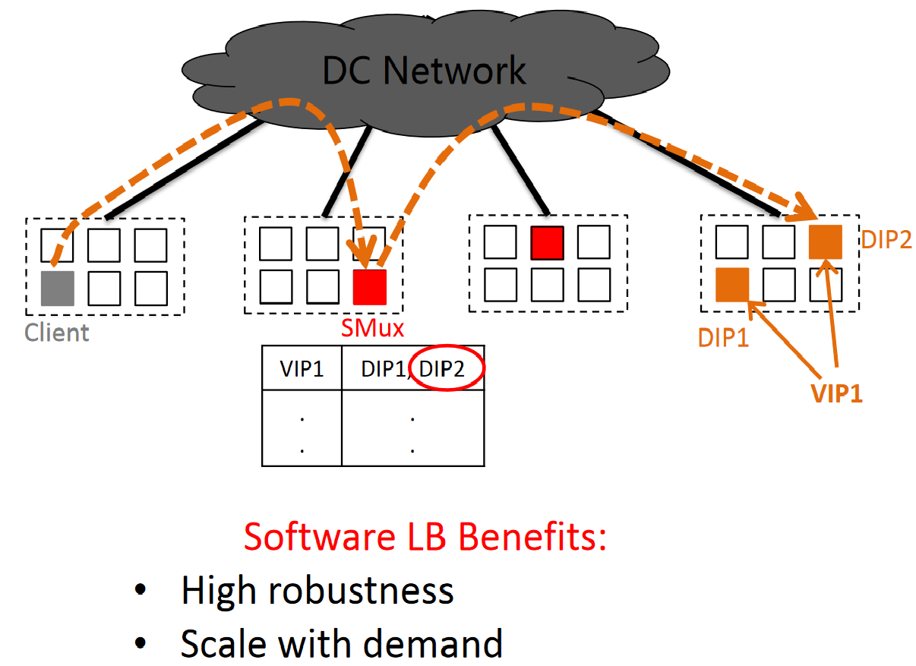
Pure Software LB
Request → VIP
SMUX is software LB

Slide 11
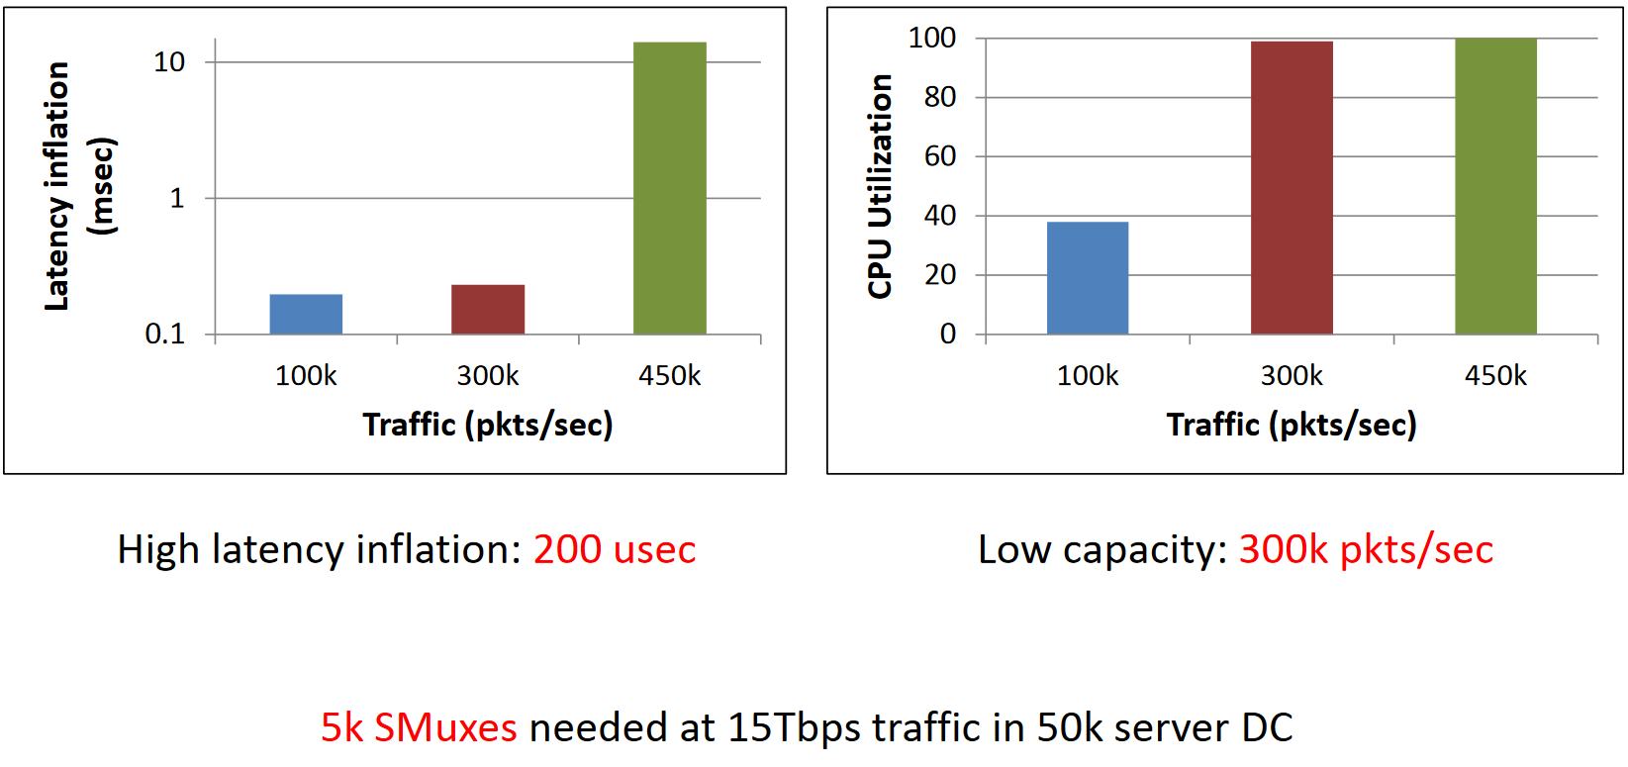
Software Drawbacks
Taken from [Duet`15]

Slide 12
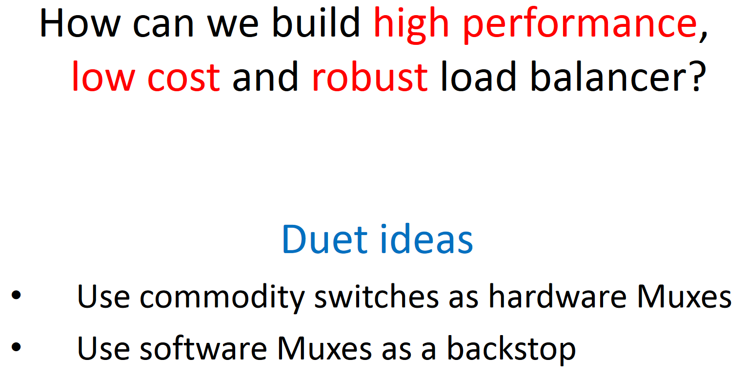
Duet

Slide 13
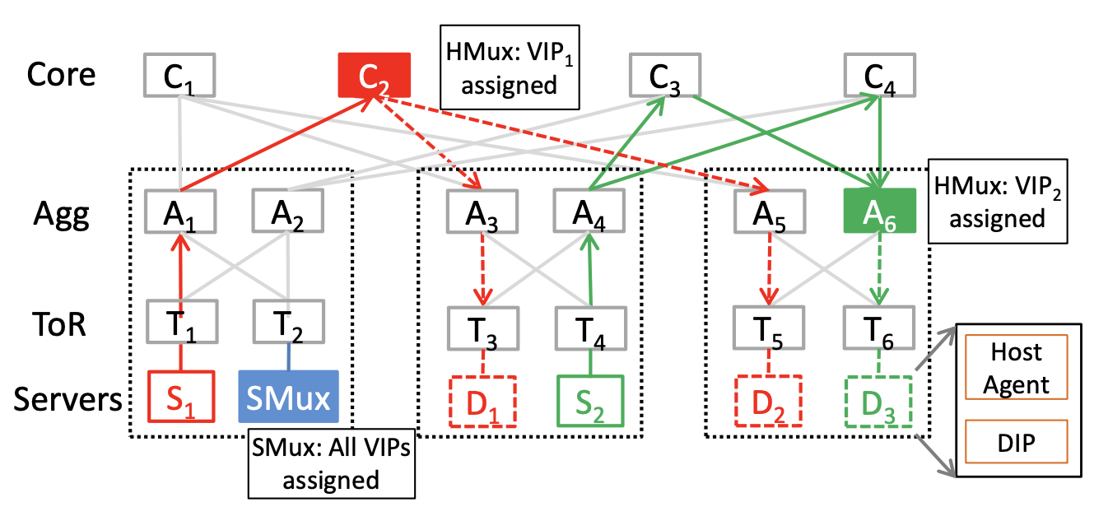
DUET Architecture
VIPs are partitioned across different HMuxes — VIP1 and VIP2 are assigned to HMux C2 and A6.
SMuxes act as backstop for all the VIPs.
Every server (apart from SMuxes) with host agent decapsulates the packets and forwards to DIP.
Links marked with solid lines carry VIP traffic, and links with dotted lines carry DIP traffic.

Slide 14
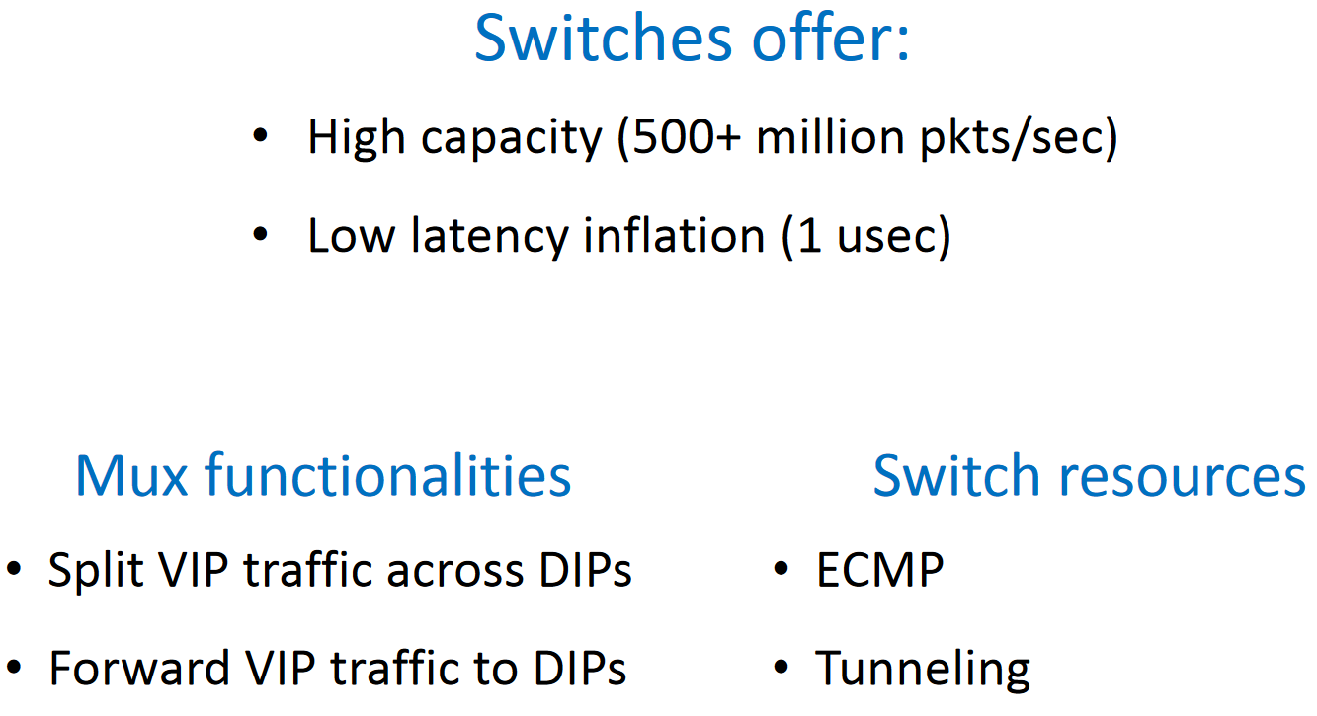
Can we use commodity switches?

Slide 15
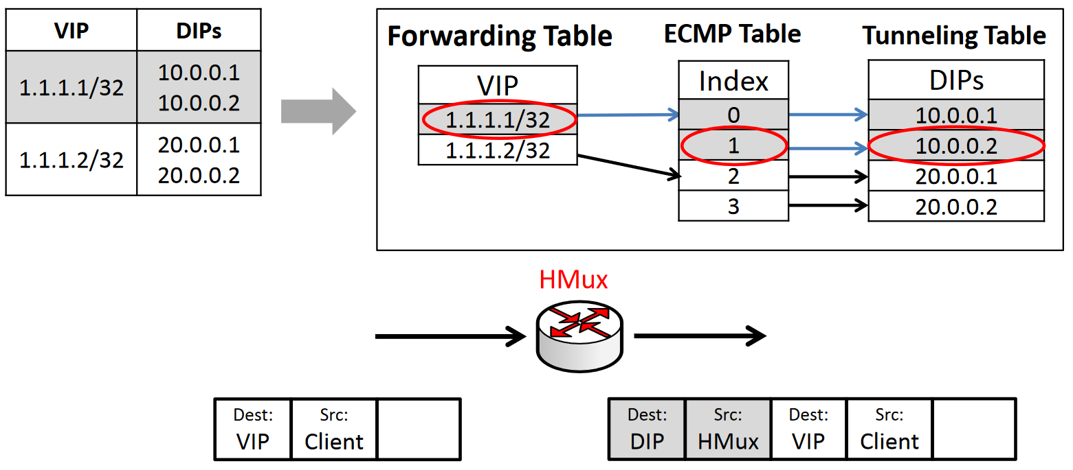
Commodity Switches Hardware LBs
Routers can do ECMP
Routers cannot swap VIP with DIP
So, use tunneling to replace swapping
Notes:
Change into animation

Slide 16
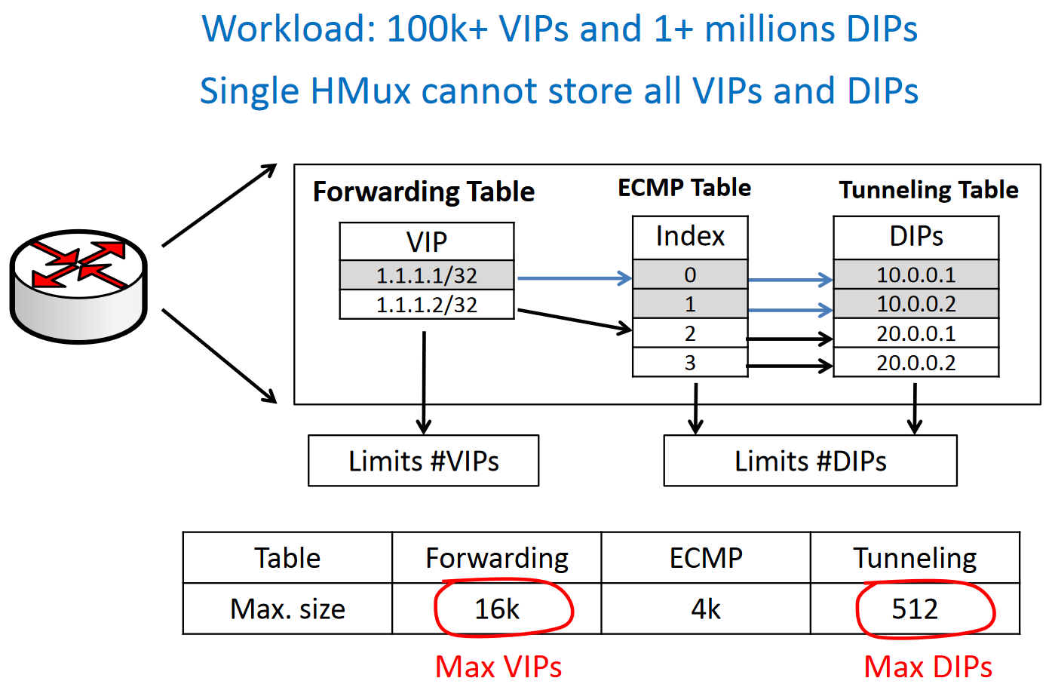
Challenge #1: Limited Memory
Notes:
Add the calculation

Slide 17
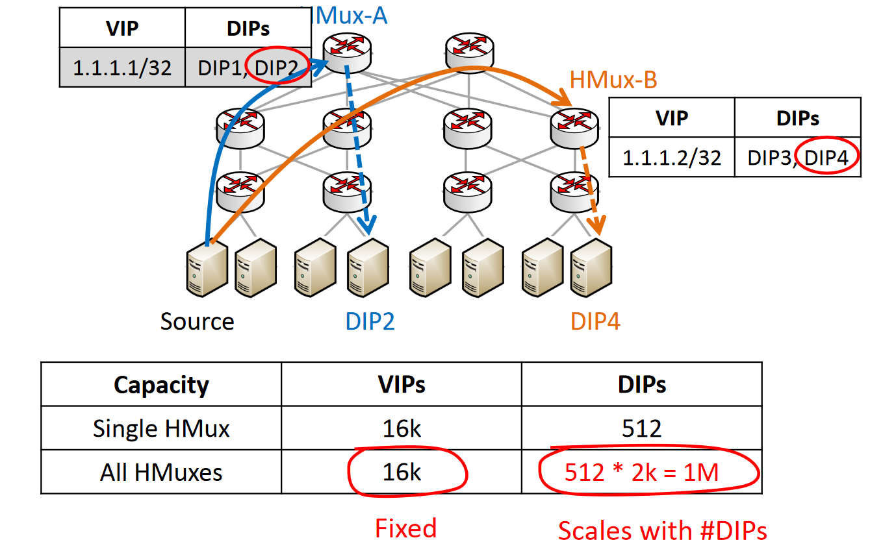
Solution to #1: Partitioning VIPs on Multiple Switches
Two-stage LB
User randomly chooses one of 2k VIPs (Hmux)
Each VIP ECMP to one of 512 DIPs
In total, support 1M DIPs per service
Notes:
Needs animation
Fix the HMUX

Slide 18
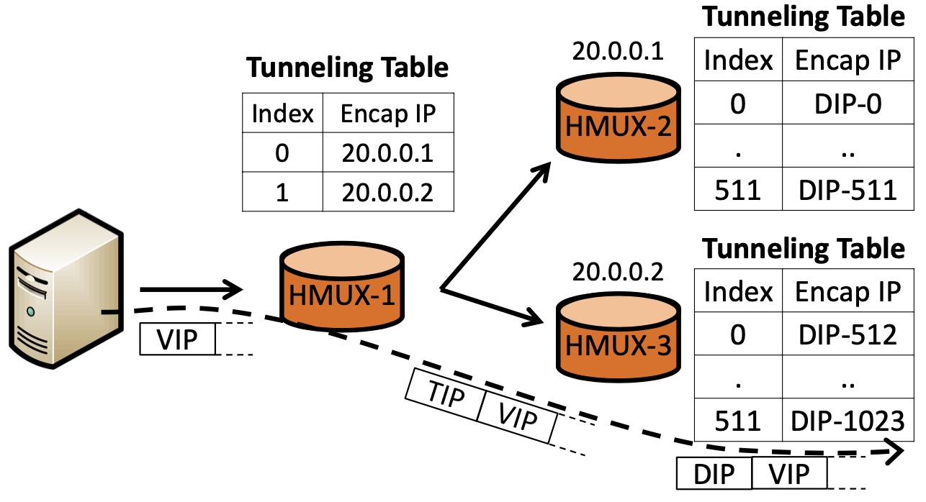
Large Fanout Support
Divide the DIPs into multiple partitions, each with at most 512 entries.
Assign a single transient IP (TIP) for each partition (e.g., 20.0.0.1, 20.0.0.2).
Store the TIPs (as opposed to DIPs) in the first tunneling table (HMUX-1).
HMux encapsulates the packet with one of the TIPs (TIP,VIP).
The switch (HMUX-2 or HMUX-3) decapsulates the TIP header and re-encapsulates the packet with one of the DIPs, and forwards it to the DIPs.
Support up to 512 ∗ 512 = 262, 144 DIPs for a single VIP.

Slide 19
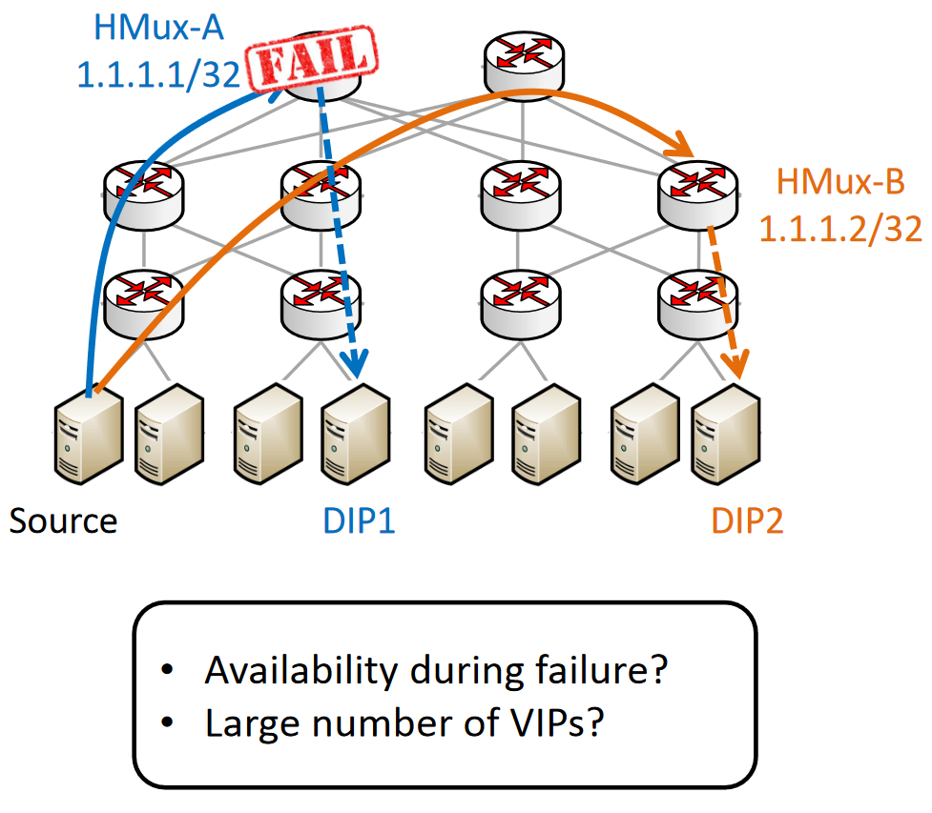
Challenge #2: High Availability

Slide 20
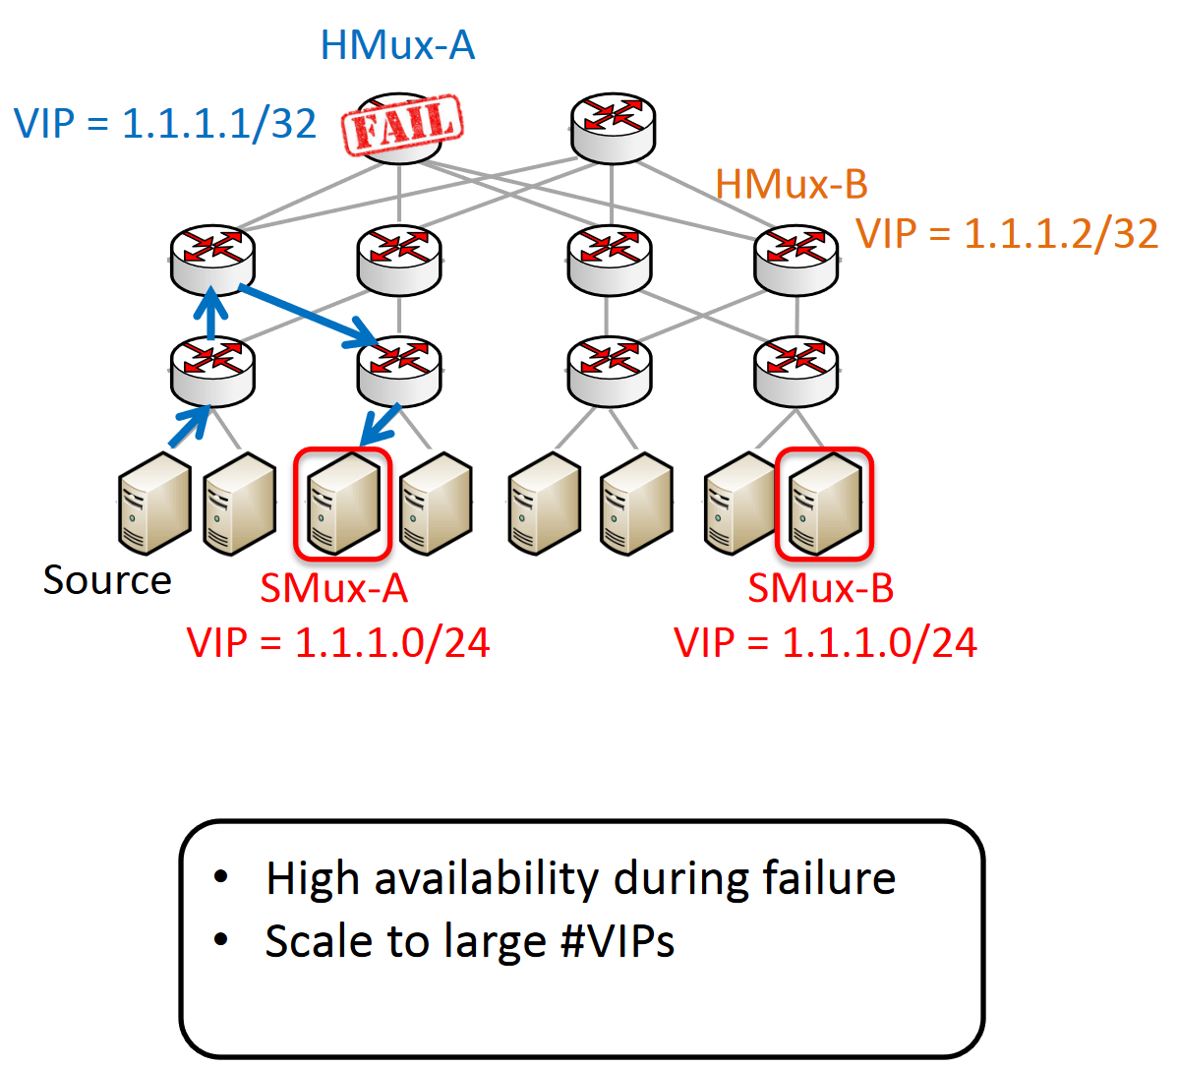
Solution to #2: Use SMuxes as Backstop
SMux is a backup of HMux
SMux’s VIP is BGP to all switches with a higher link cost to be chosen lastly
When a HMux fails, requests are forwarded to SMux
SMux has a very large VIP/DIP mapping table
So, it uses /24 to backup many /32 VIPs that have a smaller mapping table

Slide 21
2. Silkroad
[Silkroad`17]: Miao, Rui, et al. "Silkroad: Making stateful layer-4 load balancing fast and cheap using switching ASICs." Sigcomm, 2017.
(https://dl.acm.org/doi/10.1145/3098822.3098824)

Slide 22
Layer-4 Load Balancing
VIP1
DIP4
L4 Load Balancer
VIP2
VIP1
– Virtual IP
DIP1
DIP2
DIP3
DIP4
DIP5
– Direct IP
Layer-4 load balancing is a critical function
handle both inbound and inter-service traffic
>40%* of cloud traffic needs load balancing (Ananta [SIGCOMM’13])
Notes:
L4 load balancer distributes the traffic for a service to a pool of servers.
Each service in the cloud is assigned with a virtual IP address. We call it VIP.
Each service is running on a pool of servers and each server has a direct IP address. We call it DIP.
For example, the request for VIP1 arrives at load balancer first and the load balancer selects DIP4 and then sends the request to the DIP4.
Layer-4 load balanacer is a critical function for cloud data centers,
because it handles not only the traffic from Internet coming into the cloud, but also the traffic across services within the cloud. Previous study has shown that more than 40% of cloud traffic needs layer-4 load balancing.
Next, I will talk about the challenges for building such layer-4 load balancer in cloud data centers.

Slide 23
Scale to traffic growth
Cloud traffic has a rapid growth
doubling every year in Google, Facebook (Jupiter Rising [SIGCOMM’15])
L4: can we scale out load balancing to match
the capacity of physical network?
L2/L3: one big virtual switch
Multi-rooted topology
Datacenter transport
…
Notes:
Today, layer-4 load balancing becomes especially challenging because the amount of cloud traffic doubles every year.
And it means we require load balancing to not only handle the large traffic today, but also automatically scale out for the traffic growth in the future.
People have already scaled out L2/L3 functions, by treating data center fabric as one big virtual switch. Those works are ranging from multi-rooted topology design to datacenter transport for congestion control.
Building on top of the capacity provided by L2/L3 functions, can we scale-out L4 load balancing as well? This is the question we want to answer in SilkRoad.
“so that, as traffic grow, the service provider can easily increase their service capacity by simply adding more servers, without worrying about the load balancing could be a potential bottleneck.”

Slide 24
Frequent DIP pool updates
DIP pool updates
failures, service expansion, service upgrade, etc.
up to 100 updates per minute in a Facebook cluster
Hash function changes under DIP pool updates
packets of a connection get to different DIPs
connection is broken
VIP1
ECMP: Hash(p) = 9
L4 Load Balancer
Hash(p) % 3
Hash(p) % 2
VIP1
Notes:
To scale out, it sounds easy, because we can use ECMP at switches. ECMP naturally supports the traffic growth, but the essential challenge is the frequent DIP pool updates.
For example, when a connection arrives at L4 load balancer, asking for VIP1.
We run ECMP hashing on the header fields of the connection (like 5-tuples) to select a DIP.
Because we hash on the same header fields, all of packets of this connection will be forwarded to this DIP.
But, there is a problem because the DIP pool can change.
For example, with many devices, some of them may fail at any time. Operators may add servers for service expansion.
Service provider always wants to reboot servers to upgrade the service for adding new features, fixing bugs, and adding security patches.
We call those changes as DIP pool updates. [pause]. DIP pool updates are very common in a big data center.
In a Facebook cluster with 1000s of servers, we observe up to 100 DIP pool updates within in just a minute.
Under the DIP pool updates, the existing hash and the DIP assignment will change and some packets of a connection will get to a different DIP.
For example, here the same hash result 9 will mode 2 and the load balancer sends the packets to the second DIP.
Even a single packet of the connection is mis-delivered to a different DIP, the entire connection is broken. Because the connection lost the transport-layer state and application content.

Slide 25
Per-connection consistency (PCC)
Broken connections degrade the performance of cloud services
E.g., tail latency, service level agreement, etc.
PCC: all the packets of a connection go to the same DIP
L4 load balancing needs connection states
Notes:
Broken connections can degrade the performance of cloud services.
When the connection is broken, all the transferred data is lost.
it allows only the application to restart a new connection, which usually takes a few seconds. Tail latency and service level agreement.
We really want to ensure this property and send all the packets of a connection to the same DIP. This is called per-connection consistency or PCC. To achieve that, the L4 load balancer needs to maintain the state for each connection.

Slide 26
Design requirements
Scale to traffic growth
While ensuring PCC under frequent DIP pool updates
Notes:
To summarize the design of building a layer-4 load balancing in cloud data centers,
Previous solutions cannot achieve both requirements at the same time.

Slide 27
Existing solution 1: use software server
Ananta [SIGCOMM’13]
Maglev [NSDI’16]
L4 Load Balancer
Scale to traffic growth
PCC guarantee
Software load balancer
VIP1
High cost
1K servers (~4% of all servers) for a cloud with 10 Tbps
High latency and jitter
add 50-300 μs delay for 10 Gbps in a server
Poor performance isolation
one VIP under attack can affect other VIPs
Notes:
One solution commonly used in today’s data centers is to run layer-4 load balancing in software servers. We call them software load balancer.
Software load balancer has large DRAM to maintain connection states and guarantee PCC, but it cannot scale to traffic growth.
one data center has 10Tbps traffic. To handle such traffic, we need 1000 servers dedicated to run layer-4 load balancing, which accounts for around 4% of total physical servers in that data center. With the traffic doubling every year, we need more and more servers, which has a high cost.
Processing packets in software incurs a high latency, and with a high volume of traffic, this latency can vary between 50 to 300 us, even with the optimization like kernel bypassing. This latency matters for servicing the traffic across services within the cloud.
Last, a load balancer serves many VIPs. When one VIP is under attack, the other VIPs also get affected.
Those VIP experience latency increase and packet drops because of the poor performance isolation in software.
This is a critical challenge for many cloud data centers, because in a cloud with 100s of thousands of services, there are always some services under attacks at different times, and many other services get affected.

Slide 28
Existing solution 2: partially offload to switches
Partial offloading
Duet [SIGCOMM’14]
Rubik [ATC’15]
ECMP: Hash(p) = 9
Software load balancer
Hash(p) % 3
Hash(p) % 2
VIP1
Scale to traffic growth
No PCC guarantee
Hash function changes under DIP pool updates
switch does not store connection states
Notes:
To scale to traffic growth, one idea is to offload L4lb to switches using ECMP functions. This partial offloading is proposed by previous works.
Recall that under DIP pool updates, the hash function and DIP assignment can change.
Because switch has no connection state, some packets of a connection can go to different DIPs, and this violates PCC.

Slide 29
SilkRoad
Address such challenges using hardware primitives
 | Scale to traffic growth | PCC guarantee
Software load balancer
Partial offloading
SilkRoad
Build on switching ASICs
with multi-Tbps
Challenge: guarantee PCC under multi-Tbps
Notes:
In summary, we talked about two previous works.
SLB can guarantee PCC but cannot scale to traffic growth.
Partial offloading can scale to traffic growth, but cannot guarantee PCC
We propose SilkRoad, which addresses such challenges using hardware primitives.
which achieves both scaling to traffic growth and PCC guarantee.
SilkRoad scales to traffic growth. because we use switching ASICs and it handles a full line rate of multi-Tbps traffic.
Under such high-speed, the big challenge is how to guarantee PCC.
Next, I will describe our design in detail.

Slide 30
ConnTable in ASICs
ConnTable
store the DIP for each connection
VIPTable
store the DIP pool for each VIP
Insert
Connection | DIP
1.2.3.4:1234 ➔20.0.0.1:80 TCP | 10.0.0.2:20
hit
VIP | DIP pool
20.0.0.1:80 | 10.0.0.1:20
 | 10.0.0.2:20
miss
1.2.3.4:1234
➔20.0.0.1:80 TCP
1.2.3.4:1234 ➔10.0.0.2:20 TCP
Notes:
In SilkRoad, we have a VIPTable, which store the DIP pool for each VIP. Like here xx
To ensure PCC across DIP pool updates, we introduce ConnTable to store the DIP for each connection.
In this example, the first packet of a new connection does not have an entry in ConnTable.
It goes to VIPTable where it runs a hash to select the second DIP. xx

Slide 31
Design challenges
Challenge 1: store millions of connections in ConnTable
Approach: novel hashing design to compress ConnTable
Challenge 2: do all the operations (e.g., PCC) in a few nanoseconds
Approach: use hardware primitives to handle connection state and its dynamics
Notes:
To implement this design in ASICs, we have two challenges.
First, ConnTable needs to store the entries for all active connections, which can be a few million in the cloud data centers.
To address that, we use novel hashing design to compress ConnTable, so that it can fit into the ASIC memory.
Second, under multi-Tbps, we only have a few nanoseconds to perform all the operations, such as ConnTable lookup, selecting a DIP in VIPTable, inserting a new entry into ConnTable to ensure PCC, etc.
that is challenging because the ASIC process all the packets in a pipeline, where in every cycle, there is a new packet coming in.
we cannot drop the packets and we cannot lock or stop the pipeline, either.
To address this challenge, our design leverages the hardware primitives in switching ASICs for our function operations such as handling connection state and its dynamics.

Slide 32
Many active connections in ConnTable
Up to 10 million active connections per rack in Facebook traffic
a naïve approach: 10M * (37-byte 5-tuple + 18-byte DIP) = 550 MB
ASIC features: storing all connection states just become possible
increasing SRAM size
emerging programmability allows to use SRAM flexibly
Year | 2012 | 2014 | 2016
SRAM (MB) | 10-20 | 30-60 | 50-100
Notes:
Let’s look at challenge 1.
In Facebook traffic we studied, there are up to 10 M active connections in a top-of-rack switch.
To store those connections, a naïve approach is to store the 5 tuples and the selected DIP for each IPv6 connection.
It requires more than 500 MB memory.
Let’s look at how much memory provided in switching ASICs today.
ASIC SRAM increases a lot in recent years
and it reaches to 50-100 MB last year.
It just reaches the same order of magnitude of 500 MB we need. It is comparable now.
Traditional fixed function ASICs divide this SRAM into dedicated tables to support many functions. Most of those tables are not fully utilized and the memory is wasted.
Today, the switching ASICs become programmable now, which allows us to use SRAM flexibly.
For example, data center operator now can reduce the routing table size and completely remove MPLS table.
They can use the memory to build the exact functions they need.
We can use a large portion of SRAM for load balancing.
It is close but not enough.
Next, I will show our way to compress ConnTable to fit into ASIC SRAM.

Slide 33
Approach: novel hashing design to compress ConnTable
Compact connection match key by hash digests
False positives caused by hash digests
the chance is small (<0.01%)
resolved via switch CPU (details in the paper)
ConnTable
5-tuple
(37-byte)
Connection | DIP
[2001:0db8::2]:1234→[2001:0db8::1]:80 TCP | [1002:200C::1]:80
••• | •••
hash digest
(16-bit)
Connection | DIP
0xEF1C | [1002:200C::1]:80
••• | •••
Notes:
We compress both the match field and action field in ConnTable.
To reduce match field, we use hash digest.
Instead of storing the 5 tuples of 37-byte for each connection, we store a hash digest with only saying 16 bits.
Using hash digests introduces false positives.
If two connections hash to the same digest in the same hash location.
We found that the chance of false positive is small. It is 1 out of 10k connections with 16-bit digest. We carefully detect and resolve all false positives using switch CPU with a small software overhead.

Slide 34
Approach: compress ConnTable
Compact action data with DIP pool versioning
ConnTable
18 bytes
Connection | DIP
0xEF1C | [1002:200C::1]:80
••• | •••
x 10M entries
DIPPoolTable
store VIP-to-DIP pool mapping
ConnTable
VIP | Version | DIP pool
[2001:0db8::1]:80 | 100000 | [1002:200C::1]:80
 |  | [1002:200C::2]:80
[2001:0db8::1]:80 | 100001 | [1002:200C::1]:80
••• | ••• | •••
version
(6-bit)
Connection | Version
0xEF1C | 100000
0x1002 | 100001
••• | •••
Notes:
Next, we compress the action field.
The action field stores the DIP, which is 18 bytes. Given that we have up to 10M entries, this takes a lot of memory.
Alternatively, we can also remember the VIP to DIP pool mapping, then we can simply run a hash over the DIP pool to select the same DIP.
But, we still need ConnTable, because this DIP pool can change.
So we introduce this DIPPoolTable and assign each DIP pool a version. We store the version for each connection in ConnTable.
Now a coming packet can get its version from ConnTable, then map the version to the actual DIP pool in DIPPoolTable. We then run a hash to select the same DIP.
When the DIP pool update happens, we simply assign a new version to the new DIP pool.
New coming connections now start to use the new DIP pool version, but existing connections are still mapped to the old DIP pool version in ConnTable. So the PCC is always guaranteed.
By using version , we reduce action field to saying 6 bits.
This memory saving in ConnTable is much greater than the additional memory used for maintaining DIPPoolTable, due to the difference in table size.
This is because a DIP usually serves for 1000s of active connections.

Slide 35
3. Beamer
[Beamer`18]: Olteanu, Vladimir, et al. "Stateless datacenter load-balancing with beamer." 15th {USENIX} Symposium on Networked Systems Design and Implementation ({NSDI} 18). 2018.
(https://www.usenix.org/conference/nsdi18/presentation/olteanu)

Slide 36
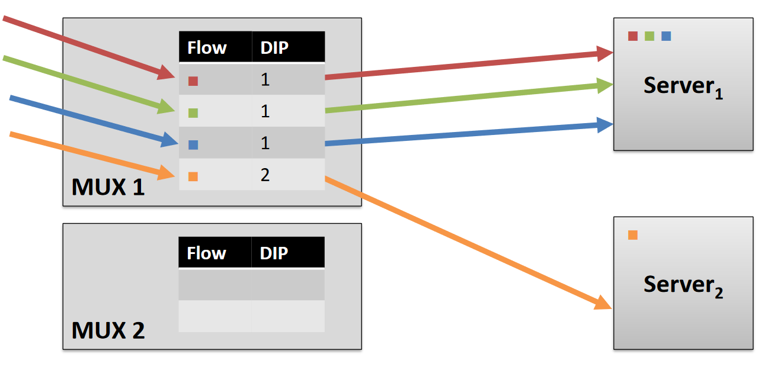
Beamer: What if we add an LB

Slide 37
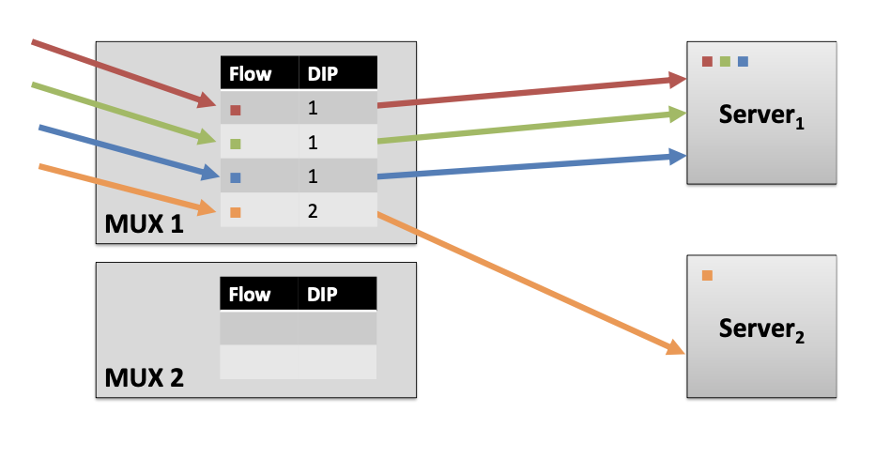
Beamer: What if we add an LB

Slide 38
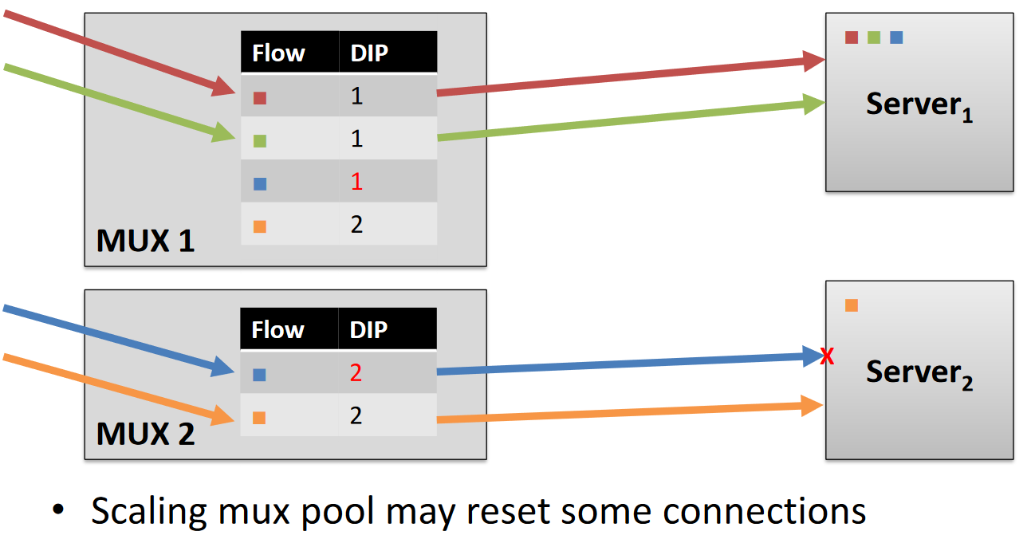
Beamer: What if we add an LB

Slide 39
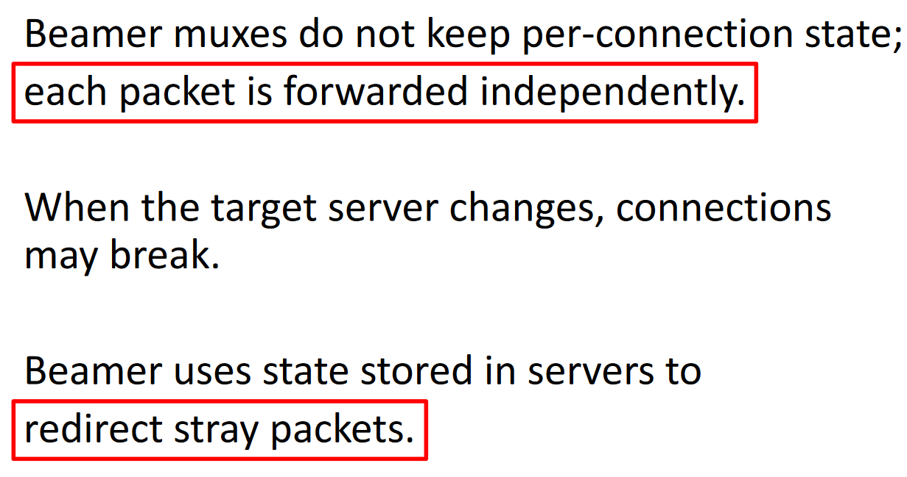
Beamer: Load Balancing should be Stateless

Slide 40
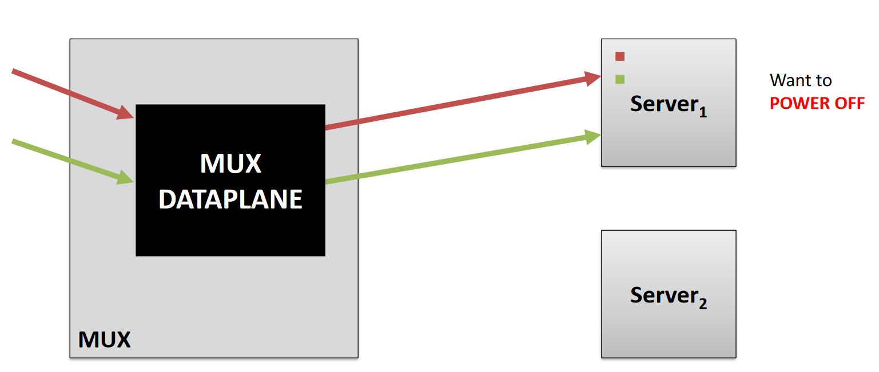
Beamer in Action

Slide 41
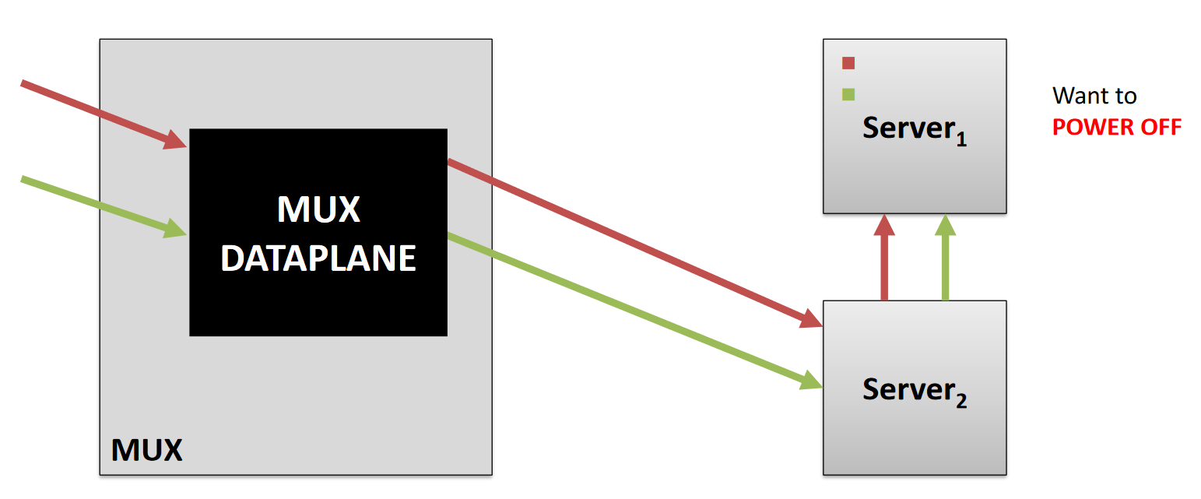
Beamer: Daisy Chaining
Notes:
When green’s packets arrive at Server2, there is no state associated with it. It means the packets belonging to an old flow are supposed to send to the other server with its DIP embedded in the packet header.

Slide 42
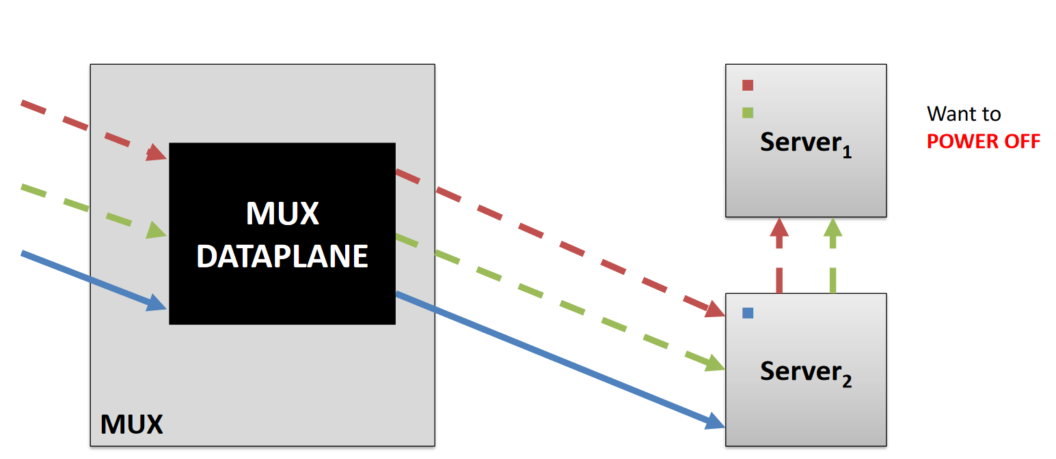
Beamer: Daisy Chaining
Daisy-chained connections
die off in time

Slide 43
Beamer Hashing
Indirection layer
Pick number of buckets B > N, number of servers, e.g., B = 100N
Mux data plane:
Assign each bucket to one server
Bucket-to-server mappings known by all muxes
Maintained by a centralized controller
Mux algorithm:
Hash each packet modulo B
Send to corresponding server

Slide 44
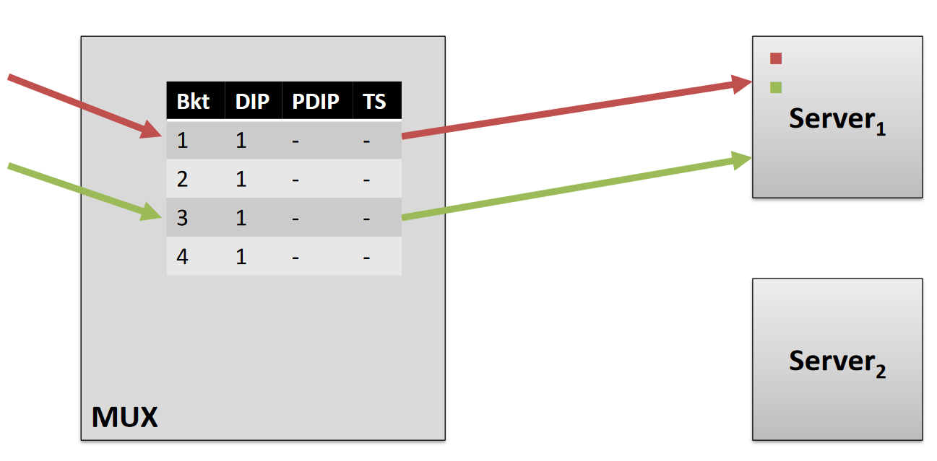
Beamer: Data Plane
Notes:
Packets are hashed to different buckets (similar to JumpFlow). By changing the serverIDs appearance numbers in the buckets we can control the split ratio to the servers.

Slide 45
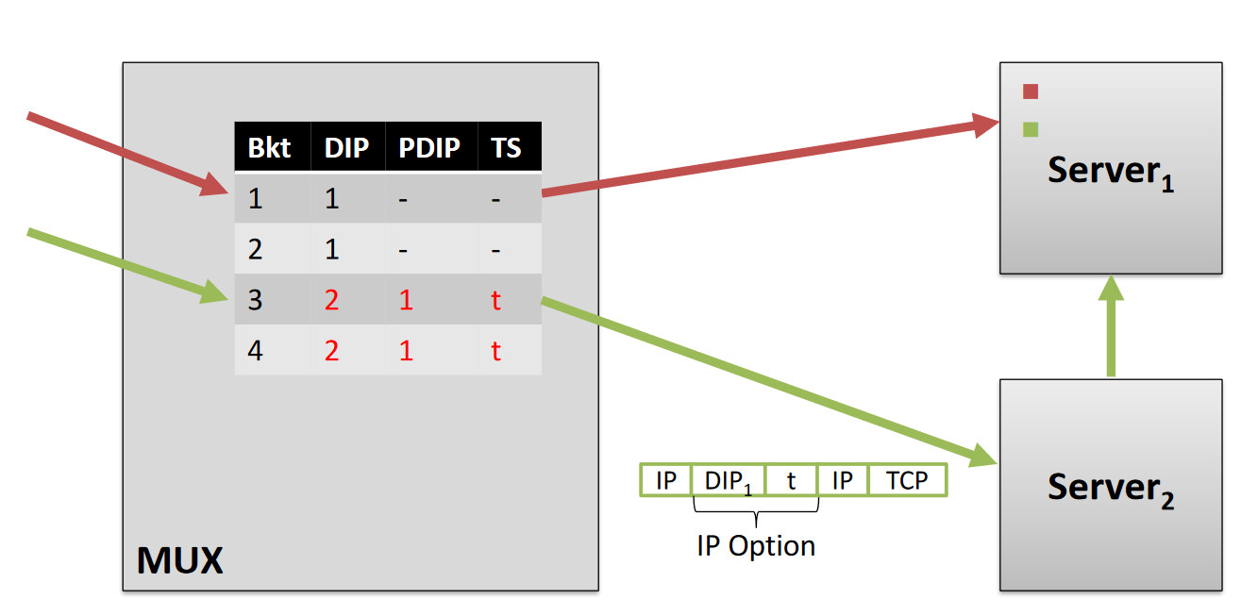
Beamer: Data Plane During a Transition
Packets contain previous server and time of reassignment
Notes:
Add something to say before bemaer we didn’t change DIP. But beamer wants to change DIP

Slide 46
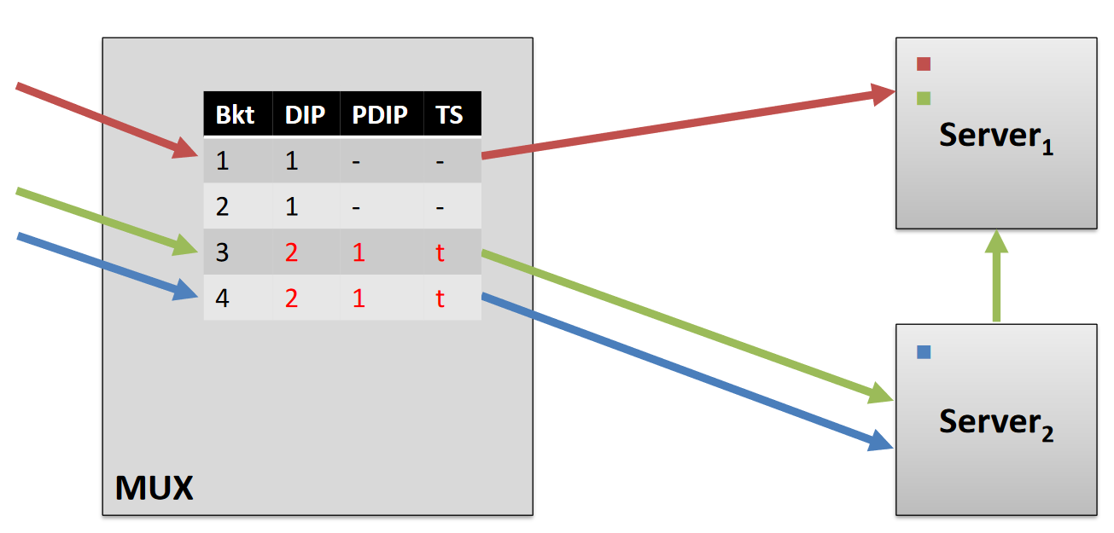
Beamer: New Connections During a Transition
New connections are handled locally
Notes:
When green’s packets arrive at Server2, there is no state associated with it. It means the packets are supposed to send to the other server with its DIP embedded in the packet header.
A TS (time stamp) t is used to facilitate timeout. After timeout (e.g., 5 minutes after installing the entry), the entry’s PDIP and TS will be removed.

Slide 47
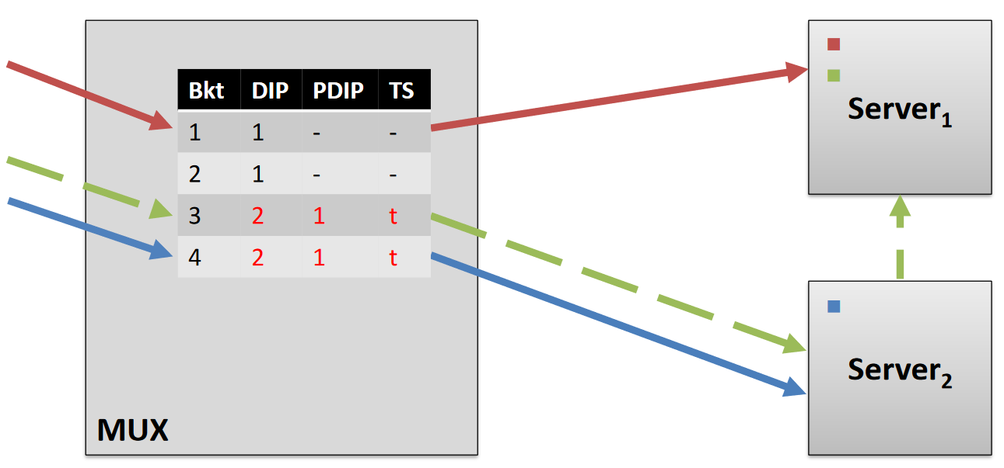
Beamer: Transitions Time Out
Daisy chained connections die off in time
Notes:
Show that we have many LBs
Do not spend too much time here
7 minutes here

Slide 48
4. Spotlight
Ashkan Aghdai; Cing-Yu Chu; Yang Xu; David Dai; Jun Xu; H. Jonathan Chao, "Spotlight: Scalable Transport Layer Load Balancing for Data Center Networks." IEEE Transactions on Cloud Computing, Sep. 18, 2020 (https://ieeexplore.ieee.org/document/9200751)

Slide 49

Problem with flow-based ECMP
Flow-based equal-cost traffic distribution is inefficient
Incoming traffic is not uniform
In most cases user demand is heavy-tailed
Serving instances (software backends or virtualized network functions) do not have the same capacity
Server’s hardware is incrementally upgraded
Due to sharing HW, the server cannot isolate the performance of VMs

Slide 50
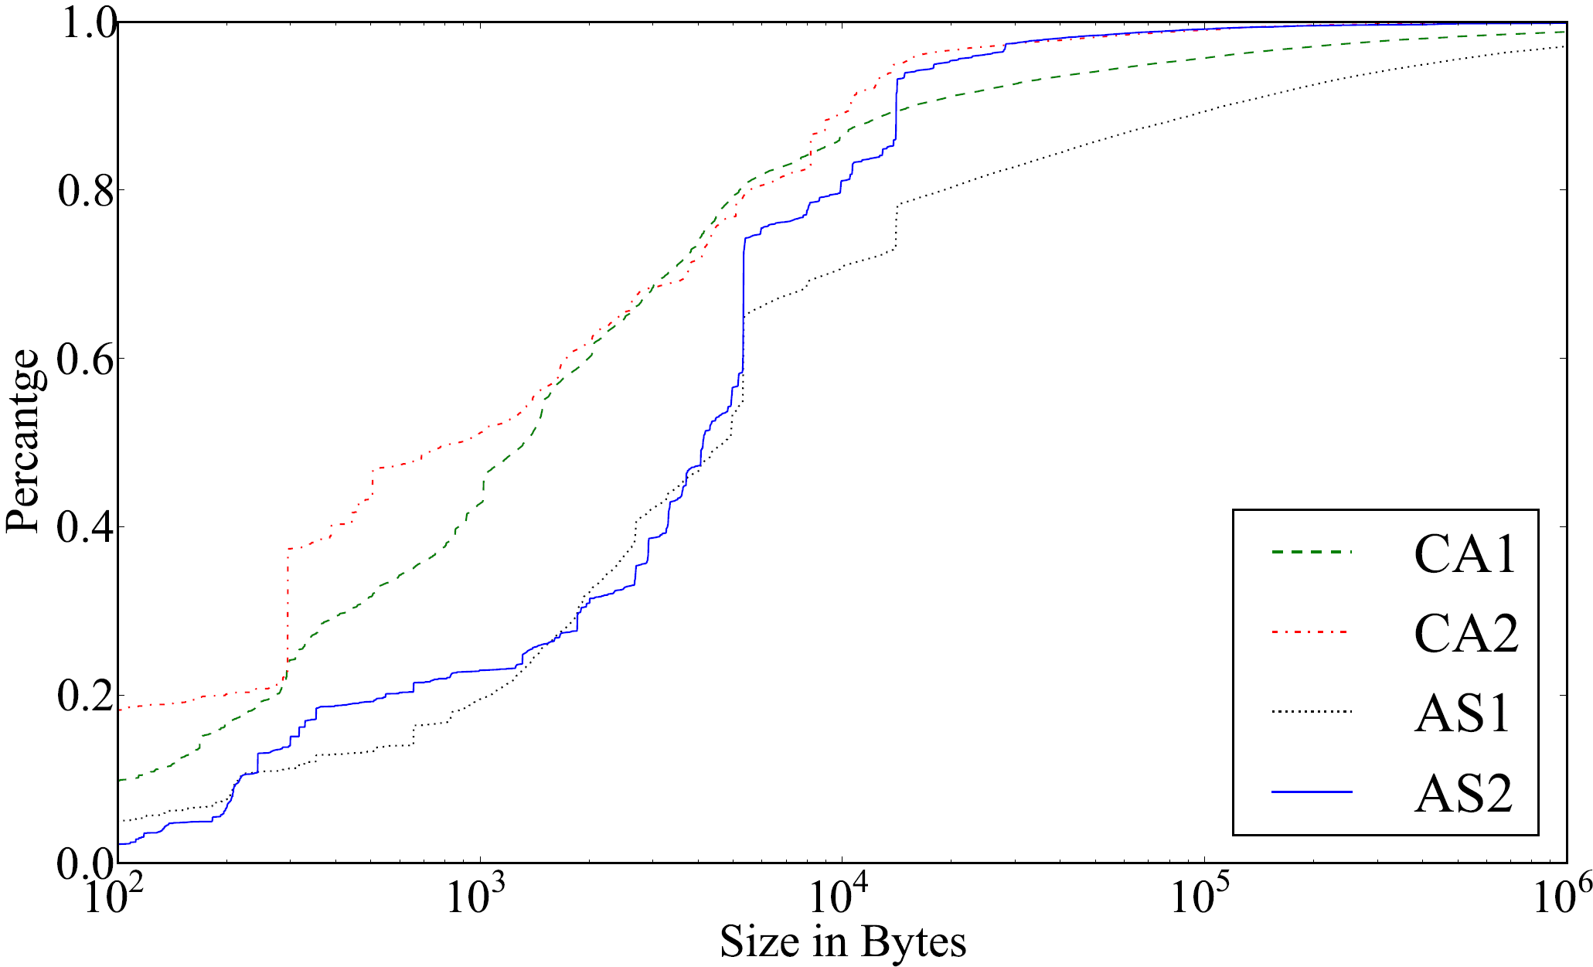
Heavy-tailed Distribution of Flows
CDF
Flow size distribution is heavy-tailed
Cloud DCs:
Alizadeh et. al SIGCOMM 2011
Greenberg et. al SIGCOMM 2009
Internet Backbone:
MAWI Wide project USENIX 2000
Enterprise DCs:
Our measurements in NYC DoE DC (HPSR`13) →
Taken from [EDC`13]

Slide 51
Spotlight: Weighted Load Balancing
A light-weight service is installed on DIPs to periodically estimate DIPs’ available capacity and send them to a controller
Controller uses available capacities to calculate new weights for DIPs and distributes the weights to load balancers
Controller
New Weights
…
Utililization
Utililization
…

Slide 52
Adaptive Weighted Flow Dispatching
Dispatch new flows to DIPs in proportion to DIPs available capacity
Challenges:
How to estimate DIPs’ available capacity?
What metric should be used to estimate the available capacity?
How to use this information in load balancers?
How new flows are assigned to DIPs?
How to maintain the connection affinity (AKA PCC)?
How do we make sure existing connections get routed to already-assigned DIPs?
Controller
Update Weights

Slide 53
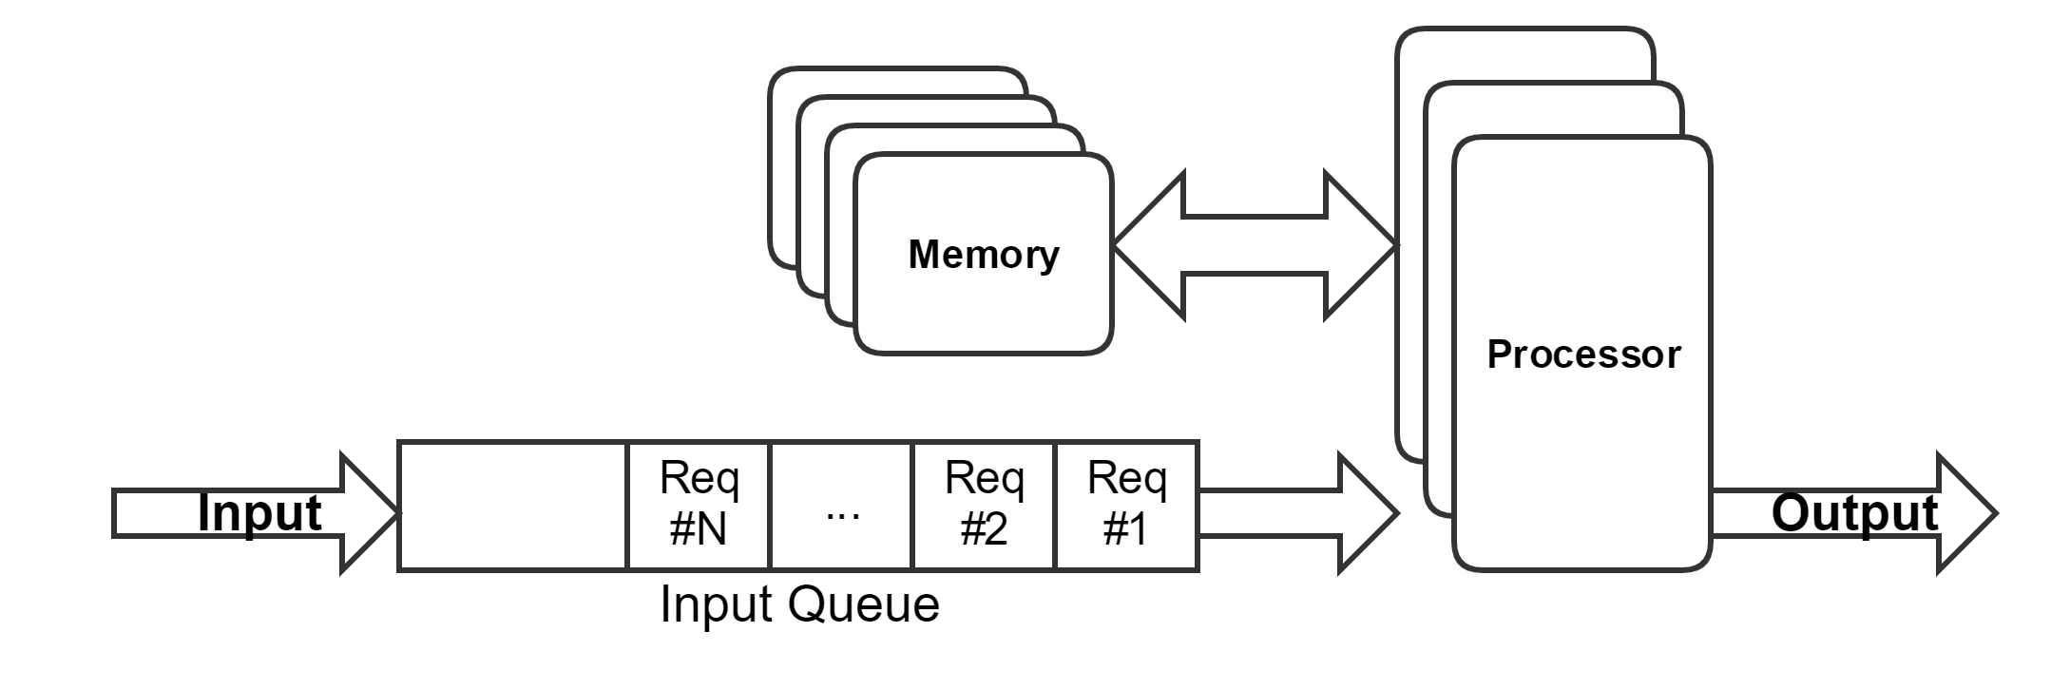
Estimation of Available Capacity
The processor model:
Resources:
CPU Cycles
Memory I/O rate
Network I/O rate
Available Capacity of a DIP is defined as:
Available capacity of highest-utilized resource
Input queue length can also be used to estimate the available capacity when we do not know which resource is the bottleneck

Slide 54
Data Plane: Maintaining PCC
We use a connection table to maintain connection affinity for existing connections.
Physical View on a
Programmable Switch
PKT IN
Logical View
PKT IN
Is it a New Connection?
Add
Assign the connection to a DIP according to weights
Yes
Connection #1 | DIP₅
Connection #2 | DIP₁
… | …
Flow Dispatcher
Miss
No
Modify Headers
Load the previous assignment from the connection table
Memorize the new assignment in the connection table
Hit
Connection Table
PKT OUT
PKT OUT
PKT OUT

Slide 55
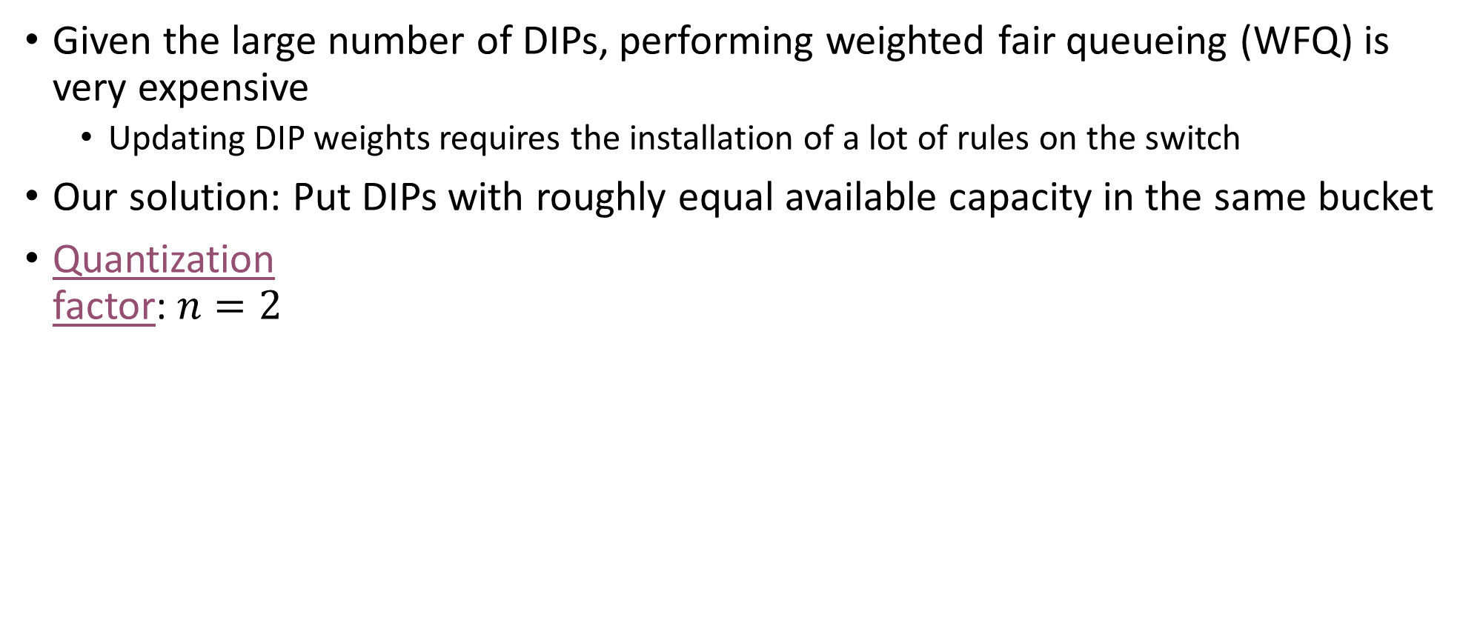
Data Plane: Weighted Flow Dispatching
Given the large number of DIPs, performing weighted fair queueing (WFQ) is very expensive
Updating DIP weights requires the installation of a lot of rules on the switch
Our solution: Put DIPs with roughly equal available capacity in the same bucket
Quantization factor: $n=2$
Adaptive Weighted Flow Dispatching (AWFD)
Stage I:
Choose a Bucket
Stage II:
Choose a DIP from the Bucket
New Flow
Add to table
1
1
2
.1
2
B₀
B₁
B₂
Weight of B_{j}: $j\left\|B_{j}\right\|$ 0*1 1*2 2*2

Slide 56

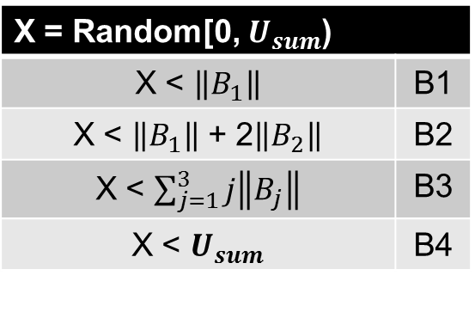
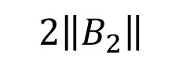

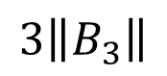
AWFD: Stage I
Weighted Flow Dispatching (WFD)
Stage I: Choose a Bucket
X = Random[0, $U_{sum}$)
X < $\left\|B_{1}\right\|$ | B1
X < $\left\|B_{1}\right\|$ + 2$\left\|B_{2}\right\|$ | B2
X < $\sum_{j=1}^{3}{j\left\|B_{j}\right\|}$ | B3
X < $U_{sum}$ | B4
Stage II:
Choose a DIP from the Bucket
New Flow
Add to table
$$4\left\|B_{4}\right\|$$
$$3\left\|B_{3}\right\|$$
$$2\left\|B_{2}\right\|$$
$$\left\|B_{1}\right\|$$
$U_{sum}$ = Sum(weights)

Slide 57
AWFD: Complete Algorithm
Weighted Flow Dispatching (WFD)
Stage I: Choose a Bucket
X = Random[0, $U_{sum}$)
X < $\left\|B_{1}\right\|$ | B1
X < $\left\|B_{1}\right\|$ + 2$\left\|B_{2}\right\|$ | B2
X < $\sum_{j=1}^{3}{j\left\|B_{j}\right\|}$ | B3
X < $U_{sum}$ | B4
Stage II:
ECMP on the chosen Bucket
New Flow
Add to table
All DIPs in the same bucket have the same weight. So after choosing one of the buckets, we rely on ECMP to choose a DIP.

Slide 58
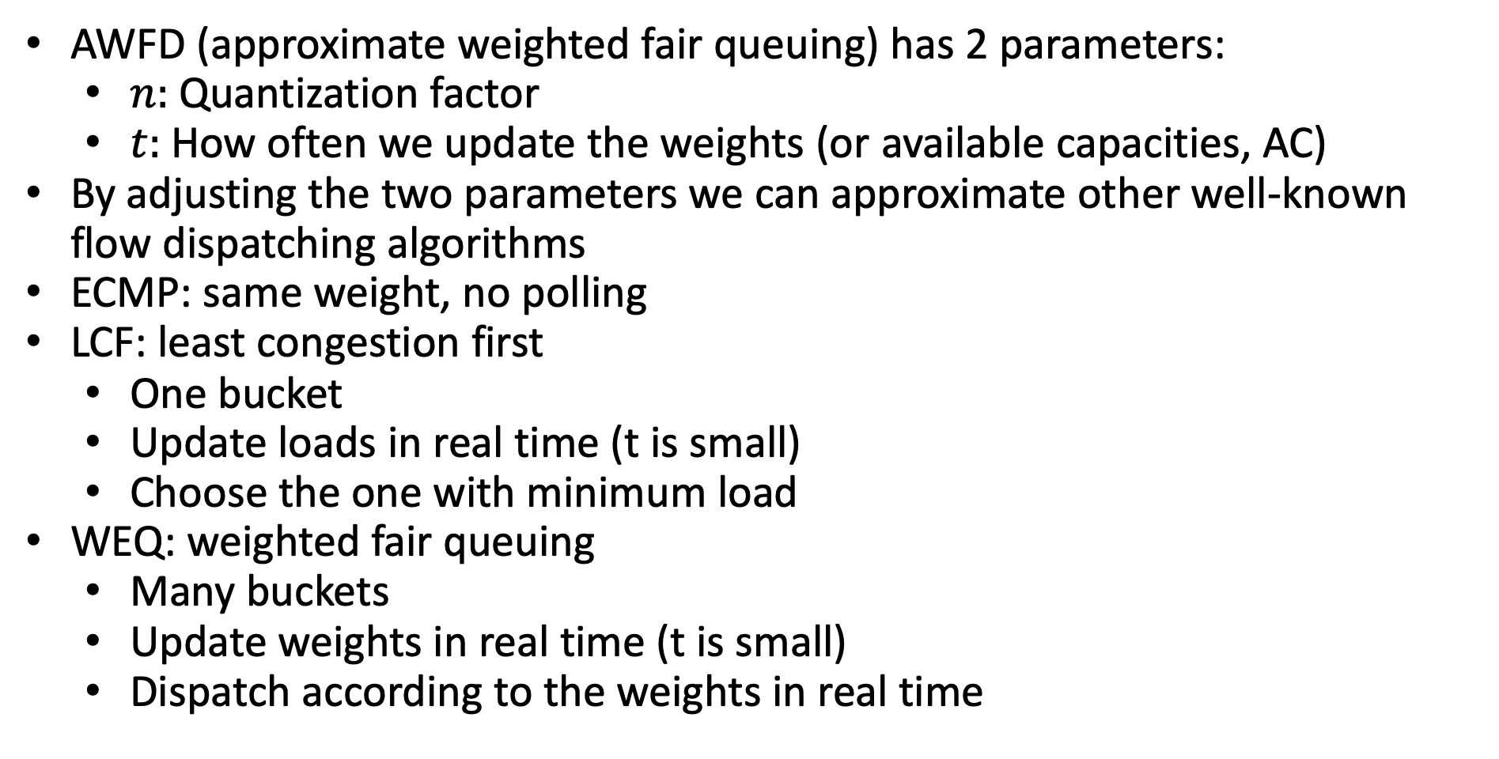
AWFD: Generalized Algorithm
AWFD (approximate weighted fair queuing) has 2 parameters:
$n:$Quantization factor
$t:$ How often we update the weights (or available capacities, AC)
By adjusting the two parameters we can approximate other well-known flow dispatching algorithms
ECMP: same weight, no polling
LCF: least congestion first
One bucket
Update loads in real time (t is small)
Choose the one with minimum load
WEQ: weighted fair queuing
Many buckets
Update weights in real time (t is small)
Dispatch according to the weights in real time

Slide 59
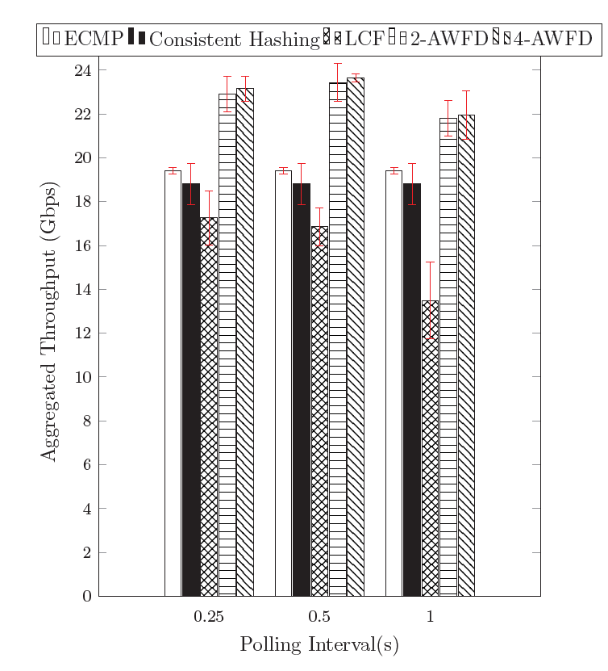

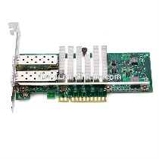
Aggregated Service Throughput
Python Controller
CURL Request Gen
40G
10G
Hosts 1 .. 8 (DIPs 1 .. 16)
2-AWFQ: 2 buckets
Notes:
Simulation results

